Slide 1

SCSA1602 - NETWORK SECURITY Unit-3

Slide 2

Syllabus

Slide 3
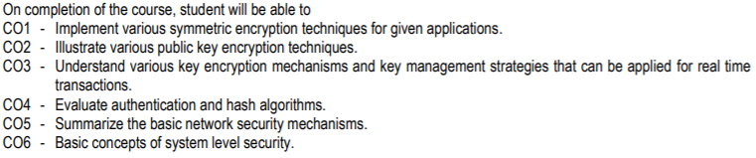
Course Outcomes

Slide 4
Number Theory
Number theory is the study of the integers.
Why anyone would want to study the integers is not immediately obvious.
First of all, what’s to know? There’s 0, there’s 1, 2, 3 and so on, and there’s the negatives. Which one don’t you understand?
After all, the mathematician G. H. Hardy wrote: [Number theorists] may be justified in rejoicing that there is one science, at any rate, and that their own, whose very remoteness from ordinary human activities should keep it gentle and clean. What most concerned Hardy was that number theory not be used in warfare; he was a pacifist. Good for him, but if number theory is remote from all human activity, then why study it? We’ll come back to that question later on, but ironically, we’ll see that poor Hardy must be turning in his grave.

Slide 5
Introduction
Introduce finite fields of increasing importance in cryptography
AES, Elliptic Curve, IDEA, Public Key
Concern operations on “numbers”
where what constitutes a “number” and the type of operations varies considerably
Start with basic number theory concepts

Slide 6
Divisors
Say a non‐zero number b divides a if for some m
have a=mb (a,b,m all integers) that is b divides into a with no remainder
Denote this b|a and say that b is a divisor of a
eg. all of 1,2,3,4,6,8,12,24 divide 24
eg. 13 | 182; –5 | 30; 17 | 289; –3 | 33; 17 | 0

Slide 7
Properties of Divisibility
If a|1, then a = ±1.
If a|b and b|a, then a = ±b.
Any b /= 0 divides 0.
If a | b and b | c, then a | c
– e.g. 11 | 66 and 66 | 198 x 11 | 198
If b|g and b|h, then b|(mg + nh)
for arbitrary integers m and n
e.g. b = 7; g = 14; h = 63; m = 3; n = 2
hence 7|14 and 7|63

Slide 8
Division Algorithm
if divide a by n get integer quotient q and integer remainder r such that:
– a = qn + r where 0 <= r < n; q = floor(a/n)
remainder r often referred to as a residue

Slide 9
Divisibility
When dividing an integer by a second nonzero integer, the quotient may or may not be an integer.
For example, 12/3 = 4 while 9/4 = 2.25.
The issue of divisibility is addressed in the following definition.
Definition
If a and b are integers with a ƒ= 0, we say that a divides b if there exists an integer c such that b = ac. When a divides b we say that a is a factor of b and that b is a multiple of a.
The notation a | b denotes a divides b and a ƒ | b denotes a does not divide b.
Back to the above examples, we see that 3 divides 12, denoted as 3 | 12, and 4 does not divide 9, denoted as 4 ƒ | 9

Slide 10
Divisibility PropertiesTheorem (1)
Let a, b, and c be integers. Then,
if a | b and a | c then a | (b + c);
if a | b then a | bc for all integers c; if a | b and b | c then a | c;
1
2
3
Proof: Direct proof given in class.
Corollary (1)
If a, b, and c are integers such that a | b and a | c, then a | mb + nc
whenever m and n are integers.
Proof: Direct proof given in class.

Slide 11
The division algorithm
Theorem (2, The division algorithm)
Let a be an integer and d a positive integer. Then, there are unique integers q and r, with 0 ≤ r < d, such that a = dq + r.
d is called the divisor;
a is called the dividend;
q is called the quotient; this can be expressed q = a div d;
r is called the remainder; this cane be expressed r = a mod d;
Example:
If a = 7 and d = 3, then q = 2 and r = 1, since 7 = (2)(3) + 1.
If a = −7 and d = 3, then q = −3 and r = 2, since −7 = (−3)(3) + 2.

Slide 12
Using successive subtractions to find q and r:
a = 101 and d = 11
101
- 11 |  | 46
90 |  | - 11
- 11 |  | 35
79 |  | - 11
- 11 |  | 24
68 |  | - 11
- 11 |  | 13
57 |  | - 11
- 11 |  | 2
46
q = 9 as we subtracted 11, 9 times
r = 2 since this was the last value before getting negative.

Slide 13
The Integers and Division
Proof of the previous theorem (the division Algorithm)
Existence:
Let S be the set of nonnegative integers of the form a − dq, where q is an integer. This set is nonempty because −dq can be made as large as desired (taking q as a negative integer with large absolute value). By the well-ordering property, S has a least element r = a − dq₀ for some integer q₀.
The integer r is nonnegative. It is also the case that r < d; otherwise if
r ≥ d, then there would be a smaller nonnegative element in S, namely
a − d(q₀ + 1), contradicting the fact that a − dq₀ was the smallest element of S. So, we just proved the existence of r and q, with 0 ≤ r < d. Q

Slide 14
The Integers and Division
Uniqueness:
Suppose there exist q, Q, r, R with 0 ≤ r, R < d such that a = dq + r and a = dQ + R. Assume without loss of generality that q ≤ Q. Subtracting both equations, we have d(q − Q) = (R − r). Thus, d divides (R − r), and so |d| < |(R − r)| or R − r = 0. But we know that 0 ≤ r, R < d, so
|R − r| < d, and we must have R − r = 0. This means R = r, which substituting into original equations gives a − r = dq = dQ. Since d ƒ= 0, dividing both sides of dq = dQ by d we get that q = Q. Therefore we have showed that r = R and q = Q, proving uniqueness. Q

Slide 15
Modular Arithmetic
Modular Arithmetic
Definition
If a and b are integers and m is a positive integer, then a is congruent to b modulo m if m divides a − b. We use the notation a ≡ b (mod m) if this is the case, and a ƒ≡ b (mod m), otherwise.
The following theorem says that two numbers being congruent modulo m
is equivalent to their having the same remainders when dividing by m.
Theorem (3)
Let a and b be integers and let m be a positive integer. Then, a ≡ b (mod m) if and only if a mod m = b mod m.
Example: 10 and 26 are congruent modulo 8, since their difference is 16 or
−16, which is divisible by 8. When dividing 10 and 26 by 8 we get
10 = 1 · 8 + 2 and 26 = 4 · 8 + 2. So 10 mod 8 = 2 = 16 mod 8.

Slide 16
Modular Arithmetic
Theorem (4)
Let m be a positive integer. The integers a and b are congruent modulo m
if and only if there is an integer k such that a = b + km
(Proof given in class.)
Theorem (5)
Let m be a positive integer. If a ≡ b (mod m) and c ≡ d (mod m), then
a + c ≡ b + d (mod m) and ac ≡ bd (mod m).
(Proof given in class.)

Slide 17
Modular Arithmetic
Corollary (2)
Let m be a positive integer and let a and b be integers. Then,
(a + b) mod m = ((a mod m) + (b mod m)) mod m ab mod m = ((a mod m)(b mod m)) mod m
Proof:
By the definition of mod m and the definition of congruence modulo m, we know that a ≡ (a mod m) (mod m), and b ≡ (b mod m) (mod m).
Applying Theorem 5, we get
a + b ≡ (a mod m) + (b mod m) (mod m) ab ≡ (a mod m)(b mod m) (mod m)
Using Theorem 3, from the above congruences we get the equalities in the statement of the theorem.

Slide 18
Congruences and Hashing Functions
A hashing table is a data structure that allows for direct access to data. If done carefully, and under certain assumptions, we can search for a record with a set of n records in expected time O(1).
Each record is uniquely identified by a key (e.g. of keys are student number for a student record, account number for bank account records, call number for book records in a library, etc).
One of the most common hash functions uses modular arithmetic:
h(k) = k mod m, where m is the number of memory addresses. Advantages: easy to compute, function is onto (all memory address can be used).
Since two different integers k₁ and k₂ may be mapped to the same location if k₁ ≡ k₂ (mod m), collisions may arises. Methods for finding an alternate location for a key are employed (collision resolution techniques).
Modular Arithmetic

Slide 19
Modular Arithmetic
Congruences and Pseudorandom Number Generators
We need random numbers in several types of algorithms, such as: randomized algorithms: algorithms that need to flip a coin to behave unbiasedly), simulation algorithms: where probability models are used to explain behaviour (example: arrival rate of subway passengers).
A systematic method of generating a number cannot be truly random, so we call them pseudorandom number generators. The most common method for such generators is the linear congruential method.
Pick integers a, c, m and seed x₀, with 2 ≤ a < m, 0 ≤ c, x₀ < m. Generate a sequence of numbers x₀, x₁, x₂, . . . from the seed x₀, using the congruence:
x_{n+1} = (ax_{n} + c) mod m.
The length of the period before repeats is called the period. Of course the period is at most m, and sometimes is exactly m (see textbook example). For this reason m must be large.
If we need a number in [0, 1] we simply provide x_{n}/m.

Slide 20
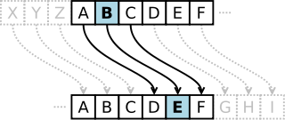
Modular Arithmetic
Congruences and Cryptography
Cryptology is the study of secret messages. One of its early uses was by Roman emperor Julius Caesar.
The Caesar cipher shifted each letter 3 letters forward in the alphabet (cyclically, sending xyz to abc respectively):
Decipher the message: JRRG OXFN LQ WKH PLGWHUP!
We can express the Caesar cipher mathematically using modular arithmetic (and generalizing the shift by 3 to a shift by k):
encryption function: f (p) = (p + k) mod 26.
decryption function: f⁻¹(p) = (p − k) mod 26

Slide 21
Primes
Primes
Definition
A positive integer p > 1 is called prime if the only positive factors of p are 1 and p. A positive integer that is greater than one and is not prime is called composite.
An integer n is composite if and only if there exists an integer a such that
a|n and 1 < a < n.
Prime numbers: 2, 3, 5, 7, 11, 13, 17, etc.
For the following composite numbers n provide a proof it is composite, that is, give a divisor a, with 1 < a < n:
Composite Numbers: 4, 6, 8, 9, 10, 12, 14, 15, etc.

Slide 22
Primes
Theorem (The Fundamental Theorem of Arithmetic)
Every positive integer greater than 1 can be written uniquely as a prime or as the product of two or more primes where the prime factors are written in order of nondecreasing size.
The proof uses strong induction, so we will delay it until the next topic. Examples:
100 = 2 · 2 · 5 · 5 = 2² · 5²
641 = 641
333 = 3 · 3 · 37 = 3² · 37
64 = 2 · 2 · 2 · 2 · 2 · 2 = 2⁶

Slide 23
Primes
Theorem
If n is a composite integer, then n has a prime divisor less than or equal to
√n.
Proof: If n is composite then n has a factor a with 1 < a < n. So, there exists an integer b > 1 such that n = ab. We claim that a ≤ √n or
b ≤ √n. Indeed, assuming by contradiction that a > √n and b > √n, we would get n = ab > √n · √n = n, a contradiction. So, a ≤ √n or
b ≤ √n. Thus, n has a positive divisor ≤ √n. If the divisor d is prime, then the theorem follows. If the divisor d is composite, then by the Fundamental Theorem of Arithmetic, it has a prime divisor p < d ≤ √n, and since p|d and d|n, we have that p divides n, and the theorem follows in this case as well. Q

Slide 24
Primes
Theorem
There are infinitely many primes.
Proof: We will use a proof by contradiction. Assume there are finitely many primes: p₁, p₂, . . . , p_{n}. Let Q = p₁p₂ · · · p_{n} + 1.
By the Fundamental Theorem of Arithmetic, Q is prime or it can be written as the product of two or more primes. In either case, there exists a prime p such that p|Q.
We claim this prime p cannot be any of the p_{i} with 1 ≤ i ≤ n. Indeed, if p_{i}|Q, we would conclude that p_{i}|(Q − p₁p₂ · · · p_{n}) = 1, which is a contradiction. Therefore, we conclude that p is a prime, and is not any of the primes listed p₁, p₂, . . . , p_{n}. But we have assumed that this was a complete list of all existing primes, and we reached a contradiction.
Q

Slide 25
GCDs and LCMs
Greatest Common Divisors
Definition
Let a and b be integers, not both zero. The largest integer d such that d|a and d|b is called the greatest common divisor of a and b, and is denoted by gcd(a, b).
Example: The positive common divisors of 24 and 36 are 1, 2, 3, 4, 6, 12. So, gcd(24, 36) = 12.
Find the following greatest common divisors: gcd(17, 100) =
gcd(1000, 625) =

Slide 26
GCDs and LCMs
Definition
The integers a and b are relatively prime if gcd(a, b) = 1.
8 and 9 are relatively prime since 8 = 2³ and 9 = 3², their only common divisor is 1, giving gcd(8, 9) = 1.
Are the following numbers relatively prime?
3 and 12
1024 and 625
7 and 15

Slide 27
GCDs and LCMs
Proposition
Let a and b be positive integers and let p₁, p₂, . . . , p_{n} be all the primes that appear in the prime factorization of a or b, so that
a a a
b b b
a = p p · · · p ,
b = p p · · · p ,
1 2 n
1 2
n
1 2 n
1 2
n
where each a_{i}, b_{i} ≥ 0 for 1 ≤ i ≤ n. Then,
min(a ,b ) min(a ,b )
min(a ,b )
gcd(a, b) = p
1 1
p
2 2
· · · p
n n
1 2
n
Proof: First note that the integer d = p
min(a ,b ) min(a ,b )
min(a ,b )
1 1
p · · · p
n n
2 2
n
1 2
divides a and b, since the power of each prime p_{i} does not exceed the power of p_{i} appearing in the factorization of each of these numbers. Second, the exponents of p_{i} in d cannot be increased, otherwise it would not divide one of a or b, and no other prime can be included. Q Example: 120 = 2³ · 3 · 5 and 500 = 2² · 5³,
_{so gcd(120, 500) = 2}min(3,2)₃min(1,0)₅min(1,3) ₌ ₂2₃0₅1 _{= 20.}

Slide 28
GCDs and LCMs
Definition
The least common multiple of the positive integers a and b is the smallest positive integer that is divisible by both a and b, denoted by lcm(a, b).
Examples: lcm(2, 10) = 10, lcm(5, 7) = 35, lcm(4, 6) = 12.
Proposition
Let a and b be positive integers and let p₁, p₂, . . . , p_{n} be all the primes that appear in the prime factorization of a or b, so that
a a a
b b b
a = p p · · · p ,
b = p p · · · p ,
1 2 n
1 2
n
1 2 n
1 2
n
where each a_{i}, b_{i} ≥ 0 for 1 ≤ i ≤ n. Then,
lcm(a, b) = p
max(a ,b ) max(a ,b )
max(a ,b )
1 1
p · · · p
2 2
n n
1 2 n
Proof: left as exercise (similar to the previous proposition)

Slide 29
GCDs and LCMs
Theorem
Let a and b be positive integers. Then,
ab = gcd(a, b) · lcm(a, b).
Proof: Write a and b as in the previous propositions
a a a
b b
b
a = p p · · · p ,
b = p p · · · p ,
1 2 n
1 2
n
1 2
n
1 2
n
By these propositions, we have
gcd(a, b) · lcm(a, b) =
min(a ,b ) min(a ,b ) min(a ,b )
p
max(a ,b ) max(a ,b )
max(a ,b )
(p
1 1
2 2
· · · p
n
n n
)(p
1 1
p
2 2
· · · p
n
n n
)
1 2
1 2
max(a ,b )+min(a ,b ) max(a ,b )+min(a ,b )
max(a ,b )+min(a ,b )
.
= p
1 1 1 1
p · · · p
n n n n
2 2 2 2
n
1 2
Now note that max(a_{i}, b_{i}) + min(a_{i}, b_{i}) = a_{i} + b_{i}. Thus,
a +b a +b
a +b
gcd(a, b) · lcm(a, b) = p p
· · · p
1 1 2 2
n
n n
1 2
a a
a b b
b
= p p · · · p p p · · · p = ab.
1 2
n 1 2
n
1 2
n 1 2
n

Slide 30
GCDs and LCMs
Towards an efficient GCD Algorithm
The methods described in Proposition 1 to calculate gcd(a, b) via the prime factorization of a and b is not efficient.
For instance, we do not know how to efficiently factor a number; that is, there are no polynomial time algorithm known that does this job. Since that method requires factoring a and b, we would need to use algorithms that do not run in polynomial time (exponential or sub-exponential time).
Note that here the input size is |log₂ a∫ + |log₂ b∫ (number of bits needed to represent a and b). An algorithm running in linear time with a and b would not be a polynomial time algorithm.
However, there is an efficient algorithm which uses only O(log(min(a, b)))
integer divisions.
This algorithm was invented by Euclid, a famous mathematician living during 325-265 B.C.

Slide 31
GCDs and LCMs
The Euclidean Algorithm
We want to calculate the gcd(91, 287).
Applying the division algorithm to 287 and 91, we get
287 = 91 · 3 + 14.
Any common divisor d of 287 and 91 must also be a divisor of 14, because
d|287 and d|91 implies d|(287 − 91 · 3) = 14.
Also, any common divisor of 91 and 14 must also be a divisor of 287. So, gcd(287, 91)=gcd(91, 14). Great! We’ve just decreased one of the numbers. Continue the process by dividing 91 by 14:
91 = 14 · 6 + 7.
Again, we conclude gcd(91, 14)=gcd(14, 7), and divide 14 by 7:
14 = 7 · 2 + 0
Because 7 divides 14 we know gcd(14, 7) = 7. Therefore, gcd(287, 91) =gcd(91, 14) =gcd(14, 7) = 7.

Slide 32
GCDs and LCMs
The Euclidean algorithm is based on the following Lemma:
Lemma
Let a = bq + r where a, b, q and r are integers. Then gcd(a, b) =gcd(b, r).
Proof: It is enough to show that the common divisors of a and b are the same as the common divisors of b and r, for then they will also share the greatest common divisor.
Suppose d|a and d|b. Then d|a − bq = r. So any common divisor of a and
b is also a common divisor of b and r.
Suppose d|b and d|r. Then d|bq + r = a So, any common divisor of b and
r is a common divisor of a and b.
Therefore, gcd(a, b) =gcd(b, r).

Slide 33
GCDs and LCMs
The Euclidean Algorithm
Correctness of the Algorithm:partial correctness+termination
Input: a and b positive integers Output: gcd(a,b)
x := max(a,b)
y := min(a,b) gcd(x,y)=gcd(a,b)
while (yƒ=0) doLoop invariant: gcd(x,y)=gcd(a,b)
r := x mod yby the previous THM: gcd(x,y)=gcd(y,r) x:=y
y:=r
endwhile (loop terminates since y≥ 0 and decreases at each iteration) postcondition gcd(x,y)=gcd(a,b) and y=0 postcondition x=gcd(x,0)=gcd(a,b)
return x

Slide 34
GCDs and LCMs
Applying Euclidean Algorithm to find gcd(123, 277):
277
123
31
30 gcd(123, 277)
= 123 · 2 + 31
= 31 · 3 + 30
= 30 · 1 + 1
=
= 1
1 · 30 + 0
x 277 123 31
y 123 31=277 mod 123 30=123 mod 31
30 1 ← gcd 1=31 mod 30 0=30 mod 1

Slide 35
Applications of Number Theory
Useful Results
Theorem (A)
If a and b are positive integers, then there exist integers s and t such that gcd(a, b) = sa + tb.
Example:
gcd(252, 198) = 18 = 4 · 252 − 5 · 198
We won’t prove this now, but will show a method for computing s and t
called the extended Euclidean Algorithm.

Slide 36
Applications of Number Theory
Extended Euclidean Algorithm
Consider the steps of the Euclidean algorithm for gcd(252, 198):
252 = 1 · 198 +54
198 = 3 · 54 +36
54 = 1 · 36 +18
36 = 2 · 18
Isolate the nonzero remainders in the above equations, substituting backwards:
gcd(252, 198) =18= 54 − 1 · 36
= 54 − 1(198 − 3 · 54) = 4 · 54 − 1 · 198
= 4 · (252 − 1 · 198) − 1 · 198 = 4 · 252 − 5 · 198
Therefore, gcd(252, 198) = 4 · 252 − 5 · 198.

Slide 37
Applications of Number Theory
Lemma (A)
If a, b, and c are positive integers such that gcd(a, b) = 1 and a|bc, then
a|c.
Proof: Using Extended Euclidean Algorithm, there exists s and t such that sa + tb = 1 =gcd(a, b). Multiplying by c, we get sac + tbc = c. Since a|bc then a|tbc. But then by the above equation since a|sac and a|tbc, we get that a|c. Q
The above Lemma generalizes to the following Lemma:
Lemma (B)
If p is a prime and p|a₁a₂ · · · a_{n}, where each a_{i} is an integer, then p|a_{i} for some i.
Proof: Do as an exercise.

Slide 38
Applications of Number Theory
Dividing both sides of a congruence
As we have seen, we can’t always divide both sides of a congruence by the same integer, even if it is non-zero.
For example:
6 ≡ 12 (mod 6), but 3 ƒ≡ 6 (mod 6).
14 ≡ 8 (mod 6), but 7 ƒ≡ 4 (mod 6).
However, we can divide by appropriate integers c, as long as gcd(c, m) = 1:
Theorem (B)
Let m be a positive integer and let a, b, and c be integers. If
ac ≡ bc (mod m) and gcd(c, m) = 1, then a ≡ b (mod m).
Proof: Since ac ≡ bc (mod m) we have that m|ac − bc = c(a − b). By Lemma A, since gcd(c, m) = 1, we have that c|(a − b). This gives
a ≡ b (mod m). Q

Slide 39
Applications of Number Theory
Solving Linear Congruences
Let m be a positive integer, a and b be integers and x be a variable. The following congruence is called a linear congruence:
ax ≡ b (mod m).
How can we solve it, i.e. find all integers x that satisfy it?
One possible method is to multiply both sides of the congruence by an inverse a of a (mod m) if one such inverse exists:
a is an inverse of a (mod m) if aa ≡ 1 (mod m).

Slide 40
Applications of Number Theory
Example:
5 is an inverse of 3 (mod 7), since 5 · 3 ≡ 15 ≡ 1 (mod 7). Using this we can solve:
3x ≡ 4 (mod 7)
5 · 3x ≡ 5 · 4 (mod 7) 1 · x ≡ 20 (mod 7)
x ≡ 6 (mod 7)
Substitute back into the original linear congruence to check that 6 is a solution:
3 · 6 ≡ 18 ≡ 4 (mod 7).
But how can we compute inverses (mod m)?

Slide 41
Applications of Number Theory
Computing inverses modulo m
Theorem
If a and m are relatively prime integers with m > 1, then an inverse of a
modulo m exists. Furthermore, this inverse is unique modulo m.
Proof: By Theorem A, since gcd(a, m) = 1, there exists s and t such that
sa + tm = 1.
This implies sa + tm ≡ 1 (mod m). Since tm ≡ 0 (mod m), so
sa ≡ 1 (mod m), which implies s is an inverse of a modulo m.
It remains to show that this inverse is unique modulo m. Suppose s and s^{j}
are inverses of a modulo m. Then,
sa ≡ 1 ≡ s^{j}a (mod m).
Since gcd(a, m) = 1, by Theorem B, we can divide both sides of the

Slide 42
Applications of Number Theory
Computing the inverse of 24 modulo 7
Applying the extended Euclidean Algorithm:
24 = 3 · 7 + 3
7 = 2 · 3 + 1
3 = 3 · 1 + 0
Using backward substitution:
1 = 7 − 2 · 3 = 7 − 2 · (24 − 3 · 7) = −2 · 24 + 7 · 7.
So s = −2 and t = 7.
−2 · 24 ≡ 1 (mod 7)
You can use as an inverse of 24 modulo 7, any integer equivalent to −2
modulo 7, such as: . . . , −9, −2, 5, 12, 19, . . .

Slide 43
Applications of Number Theory
Chinese Remainder Thm: solving systems of congruences
A Chinese Mathematician asked in the first century:
There are certain things whose number is unknown. When divided by 3, the remainder is 2; when divided by 5 the remainder is 3; and when divided by 7, the remainder is 2. What will be the number of things?
This puzzle is asking for the solution of the following system of congruences:
x ≡ 2 (mod 3),
x ≡ 3 (mod 5),
x ≡ 2 (mod 7).
The Chinese Remainder Theorem establishes that when the moduli are pairwise relatively prime, we can solve such as system of linear congruences uniquely module the product of the moduli.

Slide 44
Applications of Number Theory
Theorem (Chinese Reminder Theorem)
Let m₁, m₂, . . . , m_{n} be pairwise relatively prime positive integers and
a₁, a₂, . . . , a_{n} be arbitrary integers. Then, the system:
x ≡ a₁ (mod m₁), x ≡ a₂ (mod m₂),
... ...
x ≡ a_{n} (mod m_{n}),
has a unique solution modulo m = m₁m₂ . . . m_{n}. (That is, there is a solution x with 0 ≤ x < m, and all other solutions are congruent modulo m to this solution).

Slide 45
Applications of Number Theory
Proof of the Chinese Reminder Theorem (existence part)
In order to construct a simultaneous solution, let M_{k} = m/m_{k}. Note that
gcd(m_{k}, M_{k}) = 1. So there exists y_{k} inverse of M_{k} modulo m_{k}.
Then x = a₁M₁y₁ + a₂M₂y₂ + · · · + a_{n}M_{n}y_{n} is a simulatneous solution. Indeed, for any 1 ≤ k ≤ n, since for j ƒ= k, all terms except kth term are 0 modulo m_{k}, which gives x ≡ a₂M_{k}y_{k} ≡ a_{k} (mod m_{k}). Q
Showing that this is a unique solution is exercise 3.7-24, which is recommended.
Solving the original old question, that asks for a simultaneous solution to
x ≡ 2 (mod 3), x ≡ 3 (mod 5), x ≡ 2 (mod 7). m₁ = 3, m₂ = 5, m₃ = 7, so m = m₁m₂m₃ = 105. a₁ = 2, a₂ = 3, a₃ = 2;
M₁ = 35, an inverse of 35 modulo 3: 2 M₂ = 21, an inverse of 21 modulo
5: 1 M₃ = 15. an inverse of 35 modulo 3: 1
So the solution x ≡ a₁M₁y₁ + a₂M₂y₂ + a₃M₃y₃ ≡
2 · 25 · 2 + 3 · 21 · 1 + 2 · 15 · 1 ≡ 233 ≡ 23 (mod 105).

Slide 46
Applications of Number Theory
Fermat’s Little Theorem
Theorem (Fermat’s Little Theorem)
If p is a prime and a is an integer not divisible by p, then
a^{p−1} ≡ 1 (mod p).
Furthermore, for every integer a we have
a^{p} ≡ a (mod p).
The proof is left as an exercise, whose steps are outlined in Exercise 17 (page 244-245).
Example: p = 5
Verify that the theorem works for a = 1, 2, 3, 4: For 1 it is trivial,
2⁴ = 16 ≡ 1 (mod 5), 3⁴ = 81 ≡ 1 (mod 5), 4⁴ = 256 ≡ 1 (mod 5).

Slide 47
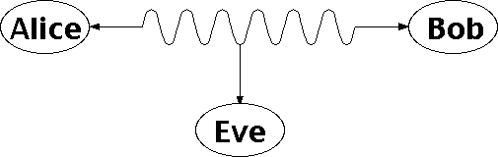
RSA cryptosystem
Public Key Cryptography and the RSA Cryptosystem
Two people, say Alice and Bob, would like to exchange secret messages; however, Eve is eavesdropping:

Slide 48
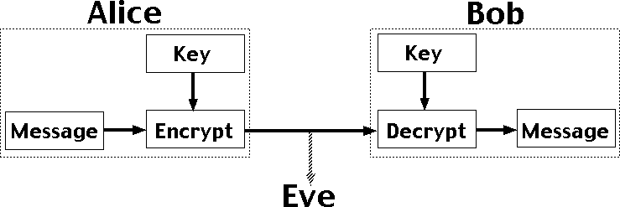
RSA cryptosystem
One technique would be to use an encryption technique based on an encryption key, but this poses a challenge: how do they exchange the encryption key without Eve receiving it?

Slide 49
RSA cryptosystem
Traditional Cryptography
In normal cryptography, both parties need to know a secret key k. The sender then encodes message m using key k via some method f to get the ciphertext c:
c = f (m, k).
Then, the receiver decodes the ciphertext c using key k via some method g
to get back the original message m:
m = g(c, k).
The issue here is how to securely exchange the secret key k.
If we could find a method of encryption / decryption such that exchanging the necessary keys does not reveal to Eve how to decrypt intercepted messages, then we would avoid this problem altogether.

Slide 50
RSA cryptosystem
Public Key Cryptosystem
The idea is that the receiver publically publishes a public key k. Then anyone who wishes to encode a message m can do so:
c = f (m, k).
The receiver has a private key k^{j} that is needed to decode the ciphertext
c to receive the original message m:
m = g(c, k).
Both the encoding technique f and the decoding technique g are also publically known; the only secret information is k^{j}.
While it is possible, it is computationally difficult to compute k^{j} from k: the key pair can be chosen so that in the amount of time it takes to derive k^{j} from k, the information m no longer has significant value.

Slide 51
RSA cryptosystem
RSA Cryptosystem
The most common form of public key cryptosystem is RSA, which stands for Rivest, Shamir, and Adleman, who invented it. It is based on modular arithmetic and large primes, and its security comes from the computational difficulty of factoring large numbers.
The idea is as follows: select p and q to be large primes (at least several hundred digits); the degree of security is dependent on the size of p and q. Take n = pq. Then the public key is a pair k = (n, e) such that:
gcd(e, (p − 1)(q − 1)) = 1.
The encoding function is:
f (m, k) ≡ m^{e} (mod n).
This assumes that the message can be represented by an integer m < n with gcd(m, p) = gcd(m, q) = 1; if not, we can break m down into smaller pieces and encode each individually.

Slide 52
RSA cryptosystem
The private key is a pair k^{j} = (n, d) such that:
de ≡ 1 (mod (p − 1)(q − 1)).
The decoding function is:
g(c, k^{j}) = c^{d} (mod n).
The security of the algorithm lies in the challenge of prime factorization: in order to calculate d, it is necessary to factor n to get p and q, which is very difficult (exponential in the number of digits in p and q).
We now proceed to show that RSA actually works.

Slide 53
RSA cryptosystem
Proof of the RSA Cryptosystem
Theorem (RSA Cryptosystem)
Let p, q be primes with n = pq and let e be an integer such that gcd(e, (p − 1)(q − 1)) = 1, with ed ≡ 1 (mod (p − 1)(q − 1)). Let m be an integer with m < n and gcd(m, p) = gcd(m, q) = 1. Define k = (n, e) and k^{j} = (n, d), and the functions:
f (m, k) = m^{d} (mod n)
g(c, k) = c^{e} (mod n).
Then we claim that:
g(f (m, k), k^{j}) = m.

Slide 54
RSA cryptosystem
Proof.
We have that:
g(f (m, k), k^{j}) = (m^{e} mod n)^{d} mod n = m^{ed} mod n.
By the choice of e and d, we have that: ed ≡ 1 (mod (p − 1)(q − 1)), or, equivalently, for some integer s, ed = 1 + s(p − 1)(q − 1). By Fermat’s Little Theorem, m^{p−1} ≡ 1 (mod p) and m^{q−1} ≡ 1 (mod q), giving:
_{m}ed _{≡ m}1+s(p−1)(q−1) _{≡ m · (m}p−1₎s(q−1) _{≡ m · 1}s(q−1) _{≡ m}
(mod p).
Similarly, m^{ed} ≡ m (mod q). Since gcd(p, q) = 1, by the Chinese Remainder Theorem, m^{ed} = m (mod pq) as required.

Slide 55
RSA cryptosystem
Note that we can apply the same argument to show that:
f (g(m, k^{j}), k) = m.
Thus, the owner of the private key can encrypt a message m using the private key, which can then be decrypted by anyone using the public key, and prove that only the private key owner could have encrypted it. This is the basis of digital signature systems.
Example: Bob wants to receive messages from Alice, so he selects two primes, say p = 43 and q = 59. (We choose small primes for feasibility of the example; in reality, they would be vastly larger.) Then n = pq = 2537 and (p − 1)(q − 1) = 2436. He then picks e = 13, which has the property that:
gcd(e, (p − 1)(q − 1)) = gcd(13, 2436) = 1.

Slide 56
RSA cryptosystem
Bob then calculates d = 937, the inverse of e mod 2436:
de ≡ 937 × 13 ≡ 12181 ≡ 5 × 2436 + 1 ≡ 1 (mod 2436).
Bob publishes the public key k = (2537, 13).
Alice wants to send message “STOP” to Bob using RSA. She encodes this: S → 18, T → 19, O → 14, P → 15, i.e. 1819 1415 grouped into blocks of 4. Thus, m = m₁m₂ = 18191415. Each block is encrypted:
1819¹³ mod 2537 = 2081
1451¹³ mod 2537 = 2182

Slide 57
RSA cryptosystem
Then the encrypted message is 20812182. Bob has private key
k^{j} = (2537, 937), and computes:
2081⁹³⁷ mod 2537 = 1819 → ST
2812⁹³⁷ mod 2537 = 1415 → OP
Thus, the original message was STOP.

Slide 59
Key Management
public-key encryption helps address key distribution problems
two aspects of this:
distribution of public keys
use of public-key encryption to distribute secret keys
Notes:
One of the major roles of public-key encryption has been to address the problem of key distribution, with two distinct aspects: the distribution of public keys, and the use of public-key encryption to distribute secret keys.

Slide 60
Distribution of Public Keys
can be considered as using one of:
public announcement
publicly available directory
public-key authority
public-key certificates
Notes:
Several techniques have been proposed for the distribution of public keys, which can mostly be grouped into the categories shown.

Slide 61
Public Announcement
users distribute public keys to recipients or broadcast to community at large
eg. append PGP keys to email messages or post to news groups or email list
major weakness is forgery
anyone can create a key claiming to be someone else and broadcast it
until forgery is discovered can masquerade as claimed user
Notes:
The point of public-key encryption is that the public key is public, hence any participant can send his or her public key to any other participant, or broadcast the key to the community at large. Its major weakness is forgery, anyone can create a key claiming to be someone else and broadcast it, and until the forgery is discovered they can masquerade as the claimed user.

Slide 62
Publicly Available Directory
Registering keys with a public directory
directory must be trusted entity or organization
contains {name, public-key} entries
is periodically published and accessed electronically
participants register securely with directory
participants can replace key at any time
still vulnerable to tampering or forgery
adversary succeeds in obtaining the private key of the directory authority
could tamper with the records kept by the authority.
Notes:
A greater degree of security can be achieved by maintaining a publicly available dynamic directory of public keys. Maintenance and distribution of the public directory would have to be the responsibility of some trusted entity or organization. This scheme is clearly more secure than individual public announcements but still has vulnerabilities to tampering or forgery.

Slide 63
Public-Key Authority
improve security by tightening control over distribution of keys from directory
has properties of directory
and requires users to know public key for the directory
then users interact with directory to obtain any desired public key securely
does require real-time access to directory when keys are needed
Notes:
Stronger security for public-key distribution can be achieved by providing tighter control over the distribution of public keys from the directory. It requires users to know the public key for the directory, and that they interact with directory in real-time to obtain any desired public key securely. Note that a total of seven messages are required, as shown next.

Slide 64
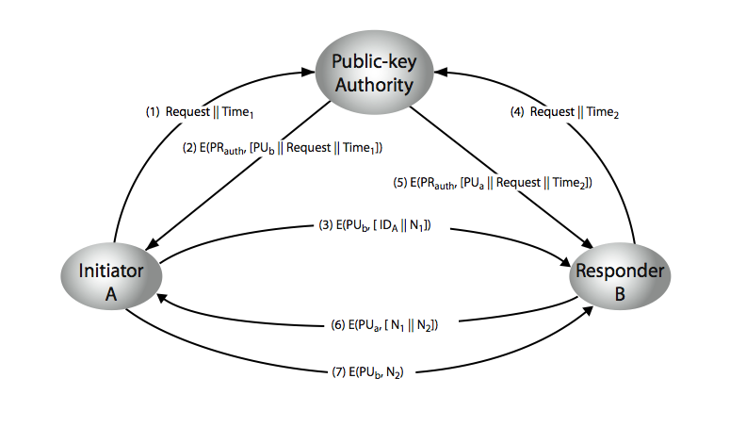
Public-Key Authority
Notes:
Stallings Figure 10.3 “Public-Key Authority” illustrates a typical protocol interaction. See text for details of steps in protocol.

Slide 65
Public-Key Authority Drawbacks
The public-key authority could be somewhat of a bottleneck in the system
A user must appeal to the authority for a public key for every other user that it wishes to contact.
As before, the directory of names and public keys maintained by the authority is vulnerable to tampering.

Slide 66
Public-Key Certificates
certificates allow key exchange without real-time access to public-key authority
a certificate binds identity to public key
usually with other info such as period of validity, rights of use etc
with all contents signed by a trusted Public-Key or Certificate Authority (CA)
can be verified by anyone who knows the public-key certificate authorities public-key
Notes:
An further improvement is to use certificates, which can be used to exchange keys without contacting a public-key authority, in a way that is as reliable as if the keys were obtained directly from a public-key authority. A certificate binds an identity to public key, with all contents signed by a trusted Public-Key or Certificate Authority (CA). This can be verified by anyone who knows the public-key authorities public-key.
One scheme has become universally accepted for formatting public-key certificates: the X.509 standard. X.509 certificates are used in most network security applications, including IP security, secure sockets layer (SSL), secure electronic transactions (SET), and S/MIME. Will discuss it in much more detail later.

Slide 67
Requirements
Any participant determine the name and public key of the certificate's owner.
Any participant can verify that the certificate originated from the certificate authority.
Only the certificate authority can create and update certificates.
Any participant can verify the currency of the certificate.

Slide 68
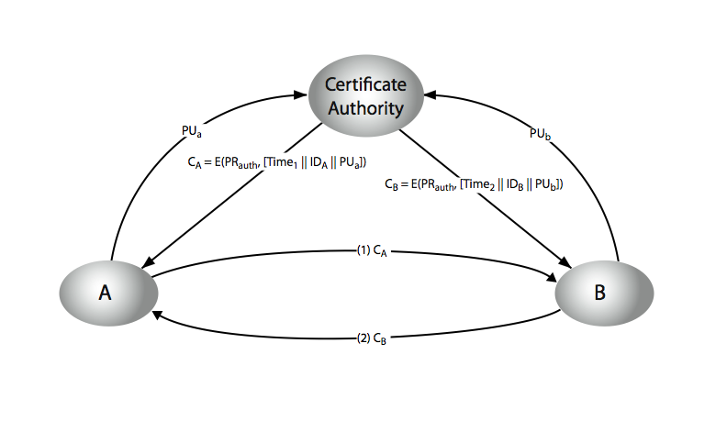
Public-Key Certificates
Notes:
Stallings Figure 10.4 “Public-Key Certificates” illustrates such a scheme. See text for details of steps in protocol.

Slide 69
Public-Key Distribution of Secret Keys
use previous methods to obtain public-key
can use for secrecy or authentication
but public-key algorithms are slow
so usually want to use private-key encryption to protect message contents
hence need a session key
have several alternatives for negotiating a suitable session
Notes:
Once public keys have been distributed or have become accessible, secure communication that thwarts eavesdropping, tampering, or both, is possible. However, few users will wish to make exclusive use of public-key encryption for communication because of the relatively slow data rates that can be achieved. Accordingly, public-key encryption provides for the distribution of secret keys to be used for conventional encryption.

Slide 70
Simple Secret Key Distribution
proposed by Merkle in 1979
A generates a new temporary public key pair
A sends B the public key and their identity
B generates a session key K sends it to A encrypted using the supplied public key
A decrypts the session key and both use (discard keys)
problem is that an opponent can intercept and impersonate both halves of protocol
adversary who can intercept messages and then either relay the intercepted message or substitute another message
Notes:
An extremely simple scheme was put forward by Merkle [MERK79]. But it is insecure against an adversary who can intercept messages and then either relay the intercepted message or substitute another message. Such an attack is known as a man-in-the-middle attack [RIVE84].

Slide 71

Man in the Middle Attack
A generates a public/private key pair {PU_{a}, PR_{a}} and transmits a message intended for B consisting of PU_{a} and an identifier of A, ID_{A}.
E intercepts the message, creates its own public/private key pair {PU_{e}, PR_{e}} and transmits PU_{e}||ID_{A} to B.
B generates a secret key, K_{s}, and transmits E(PU_{e}, K_{s}).
E intercepts the message, and learns K_{s} by computing D(PR_{e}, E(PU_{e}, K_{s})).
E transmits E(PU_{a}, K_{s}) to A.

Slide 72
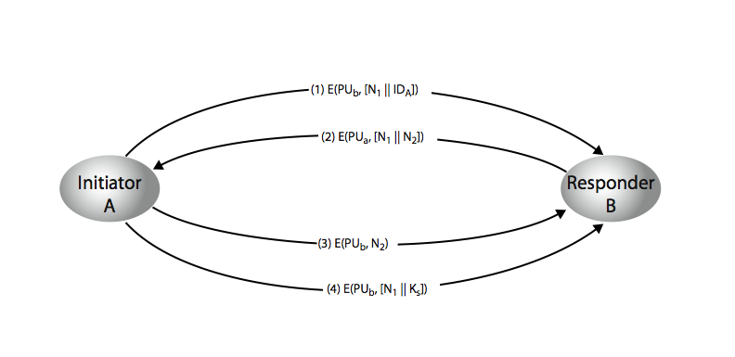
Public-Key Distribution of Secret Keys
if have securely exchanged public-keys:
Notes:
Stallings Figure 10.6 “Public-Key Distribution of Secret Keys” illustrates such an exchange. See text for details of steps in protocol. Note that these steps correspond to final 3 of Figure 10.3, hence can get both secret key exchange and authentication in a single protocol.

Slide 73
Hybrid Key Distribution
retain use of private-key KDC
shares secret master key with each user
distributes session key using master key
public-key used to distribute master keys
especially useful with widely distributed users
rationale
performance
backward compatibility
Notes:
Yet another way to use public-key encryption to distribute secret keys is a hybrid approach in use on IBM mainframes [LE93]. This scheme retains the use of a key distribution center (KDC) that shares a secret master key with each user and distributes secret session keys encrypted with the master key. A public key scheme is used to distribute the master keys. The addition of a public-key layer provides a secure, efficient means of distributing master keys. This is an advantage in a configuration in which a single KDC serves a widely distributed set of users.

Slide 74
Diffie-Hellman Key Exchange
first public-key type scheme proposed
by Diffie & Hellman in 1976 along with the exposition of public key concepts
note: now know that Williamson (UK CESG) secretly proposed the concept in 1970
is a practical method for public exchange of a secret key
used in a number of commercial products
Notes:
The idea of public key schemes, and the first practical scheme, which was for key distribution only, was published in 1977 by Diffie & Hellman. The concept had been previously described in a classified report in 1970 by Williamson (UK CESG) - and subsequently declassified in 1987, see [ELLI99].

Slide 75
Diffie-Hellman Key Exchange
a public-key distribution scheme
cannot be used to exchange an arbitrary message
rather it can establish a common key
known only to the two participants
value of key depends on the participants (and their private and public key information)
based on exponentiation in a finite (Galois) field (modulo a prime or a polynomial) - easy
security relies on the difficulty of computing discrete logarithms (similar to factoring) – hard
Notes:
The purpose of the algorithm is to enable two users to securely exchange a key that can then be used for subsequent encryption of messages. The algorithm itself is limited to the exchange of secret values, which depends on the value of the public/private keys of the participants. The Diffie-Hellman algorithm uses exponentiation in a finite (Galois) field (modulo a prime or a polynomial), and depends for its effectiveness on the difficulty of computing discrete logarithms.

Slide 76
Discrete Logarithms
a primitive root of a prime number p as one whose powers modulo p generate all the integers from 1 to p-1
For any integer b and a primitive root a of prime number p, we can find a unique exponent i such that
b ≡ a^{i} (mod p) where 0 ≤ i ≤(p-1)
The exponent i is referred to as the discrete logarithm of b for the base a, mod p.
dlog_{a,p} (b)= i

Slide 77
Diffie-Hellman Setup
all users agree on global parameters:
large prime integer or polynomial q
α being a primitive root mod q
each user (eg. A) generates their key
chooses a secret key (number): x_{A} < q
compute their public key: y_{A} = α ^{xA} mod q
each user makes public that key y_{A}
Notes:
In the Diffie-Hellman key exchange algorithm, there are two publicly known numbers: a prime number q and an integer a that is a primitive root of q. The prime q and primitive root a can be common to all using some instance of the D-H scheme. Note that the primitive root a is a number whose powers successively generate all the elements mod q. Users Alice and Bob choose random secrets x's, and then "protect" them using exponentiation to create their public y's. For an attacker monitoring the exchange of the y's to recover either of the x's, they'd need to solve the discrete logarithm problem, which is hard.

Slide 78
Diffie-Hellman Key Exchange
shared session key for users A & B is K_{AB}:
K_{AB} = α ^{xA.xB} mod q
= y_{A}^{xB} mod q (which B can compute)
= y_{B}^{xA} mod q (which A can compute)
K_{AB} is used as session key in private-key encryption scheme between Alice and Bob
if Alice and Bob subsequently communicate, they will have the same key as before, unless they choose new public-keys
attacker needs an x, must solve discrete log
Notes:
The actual key exchange for either party consists of raising the others "public key' to power of their private key. The resulting number (or as much of as is necessary) is used as the key for a block cipher or other private key scheme. For an attacker to obtain the same value they need at least one of the secret numbers, which means solving a discrete log, which is computationally infeasible given large enough numbers. Note that if Alice and Bob subsequently communicate, they will have the same key as before, unless they choose new public-keys.

Slide 79
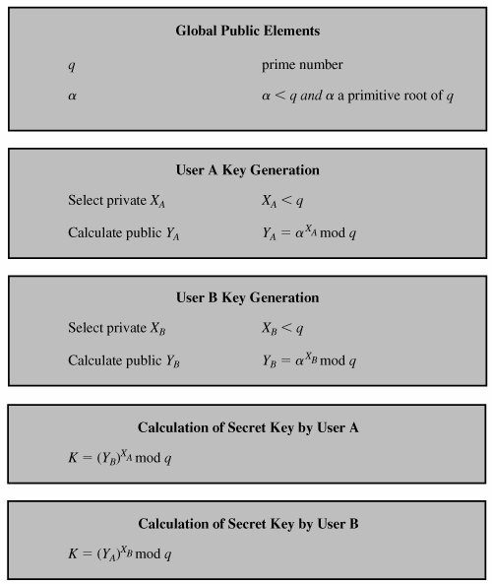

Slide 80
Security of the Diffie-Hellman
An adversary only has the following ingredients to work with: q, α, Y_{A}, and Y_{B}.
X_{A} and X_{B} are private
Calculate discrete logarithm to determine the key
X_{B} = dlog_{a,q} (Y_{B})
The security of the Diffie-Hellman key exchange lies in the fact that,
it is relatively easy to calculate exponentials modulo a prime
it is very difficult to calculate discrete logarithms. For large primes, the latter task is considered infeasible.

Slide 81
Diffie-Hellman Example
users Alice & Bob who wish to swap keys:
agree on prime q=353 and α=3
select random secret keys:
A chooses x_{A}=97, B chooses x_{B}=233
compute respective public keys:
y_{A}=3⁹⁷ mod 353 = 40 (Alice)
y_{B}=3²³³ mod 353 = 248 (Bob)
compute shared session key as:
K_{AB}= y_{B}^{xA} mod 353 = 248⁹⁷ = 160 (Alice)
K_{AB}= y_{A}^{xB} mod 353 = 40²³³ = 160 (Bob)
Notes:
Here is an example of Diffie-Hellman from the text.

Slide 82
Attack Example
An attacker would have available the following information:
q = 353; α = 3; Y_{A} = 40; Y_{B} = 248
By brute force, an attacker E can determine the common key by discovering a solution to eqns
3ª mod 353 = 40
3^{b} mod 353 = 248
calculate powers of 3 modulo 353, stopping when the result equals either 40 or 248

Slide 83
Key Exchange Protocols
users could create random private/public D-H keys each time they communicate
users could create generate a long-lasting private value X_{i} (for user i) and calculate a public value Y_{i}.
These public values and q and α, are stored in some central directory
user j can access i's public value, calculate K_{AB}
both of these are vulnerable to a meet-in-the-Middle Attack
authentication of the keys is needed
Notes:
Detail a couple of possible Key Exchange Protocols based on Diffie-Hellman. Note that these are vulnerable to a meet-in-the-Middle Attack, and that authentication of the keys is needed.

